Slide 1
Dashboard Blueprint
Team 3

Slide 2
Electric vs. Manual Bikes

Slide 3


Slide 4
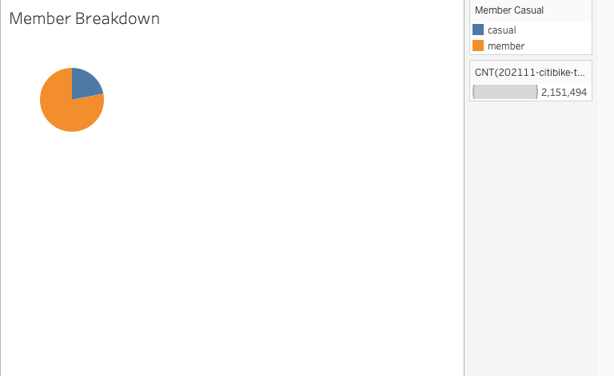

Slide 5
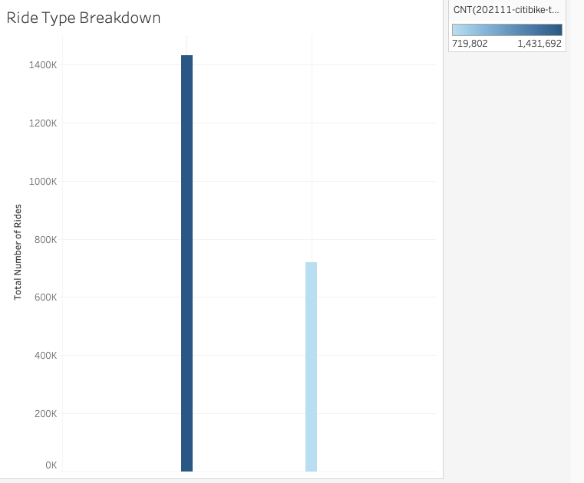

Slide 6
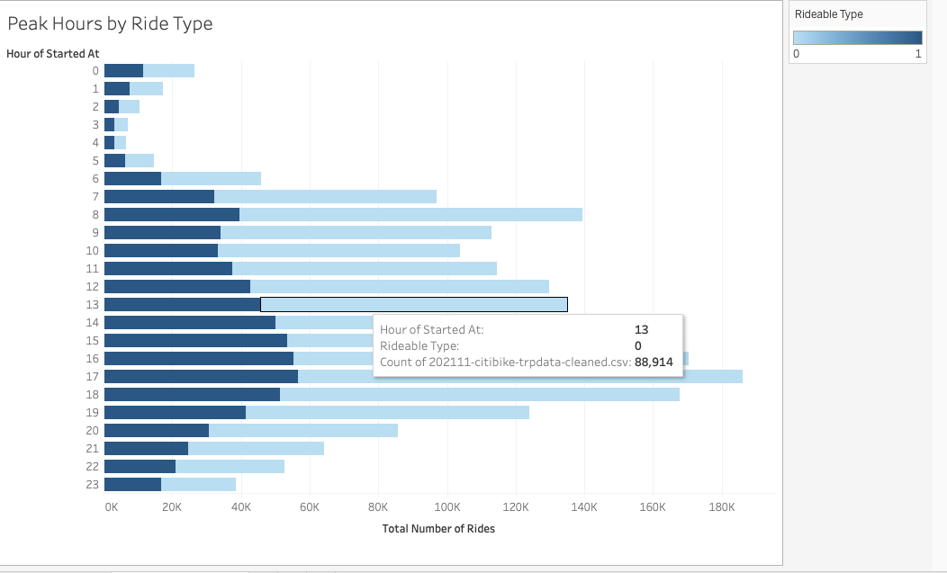

Slide 7
Final Dashboard Tools
The tools we will use to create the final dashboard will be Tableau.
Tableau is a visual analytics platform that transforms data into an engaging story for any audience.

Slide 8
Interactive Elements
Pie chart
Bar Chart
Heat Mat

